Slide 1

Introduction to Android Mobile Operating Systems

Slide 2
What is Android ?
A mobile operating system (OS) based on the Linux kernel that is currently being developed by Google.
Designed primarily for touch screen mobile devices (Smartphones and tablets)
In addition to touch screen devices, Google has further developed Android TV for televisions, Android Auto for cars, and Android Wear for wrist watches
Other devices - game consoles, digital cameras, and other electronics.

Slide 3
What is Android ?
Initially developed by Android, Inc. ( Android, Inc. was founded in Palo Alto, California, in October 2003 by Andy Rubin , Rich Miner , Nick Sears and Chris White). Google bought Android Inc. on August 17, 2005 for at least $50 million.
Android was unveiled in 2007, along with the founding of the Open Handset Alliance (OHA) (consortium of hardware, software, and telecommunication companies devoted to advancing open standards for mobile devices.)
OHA included Google, device manufacturers such as HTC, Sony and Samsung, wireless carriers such as Sprint Nextel and T-Mobile, and chipset makers such as Qualcomm and Texas Instruments.

Slide 4
What is Android ?
The first commercially available Smartphone running Android was the HTC Dream T-Mobile G1) (announced on September 23, 2008, released on October 22, 2008).
In 2010, Google with HTC launched its Nexus series of devices
Google releases the Nexus phones and tablets to act as their flagship Android devices.

Slide 5
Android Releases
Since 2008, Android has seen numerous updates
Each release improved the operating system, adding new features and fixing bugs in previous releases
Each major release is named in alphabetical order after a dessert or sugary treat.

Slide 6
Android Releases
Code name | Version number | Initial release date | API level
 | 1.0 | September 23, 2008 | 1
 | 1.1 | February 9, 2009 | 2
Cupcake | 1.5 | April 27, 2009 | 3
Donut | 1.6 | September 15, 2009 | 4
Eclair | 2.0–2.1 | October 26, 2009 | 5–7
Froyo | 2.2–2.2.3 | May 20, 2010 | 8
Gingerbread | 2.3–2.3.7 | December 6, 2010 | 9–10
Honeycomb | 3.0–3.2.6 | February 22, 2011 | 11–13
Ice Cream Sandwich | 4.0–4.0.4 | October 18, 2011 | 14–15
Jelly Bean | 4.1–4.3.1 | July 9, 2012 | 16–18

Slide 7
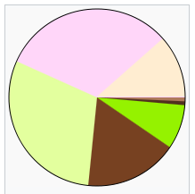
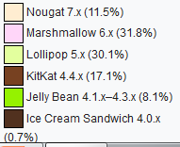
Android Releases
Code name | Version number | Initial release date | API level
KitKat | 4.4–4.4.4 | October 31, 2013 | 19–20
Lollipop | 5.0–5.1.1 | November 12, 2014 | 21–22
Marshmallow | 6.0–6.0.1 | October 5, 2015 | 23
Nougat | 7.0–7.1.2 | August 22, 2016 | 24–25
O | 8.0 | TBA | 26
Android Marshmallow is the most widely used version of Android, running on 31.8% of all Android devices
Global Android version distribution as of July 2017

Slide 8
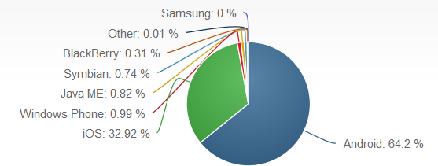
OS market share as of June, 2017

Slide 9
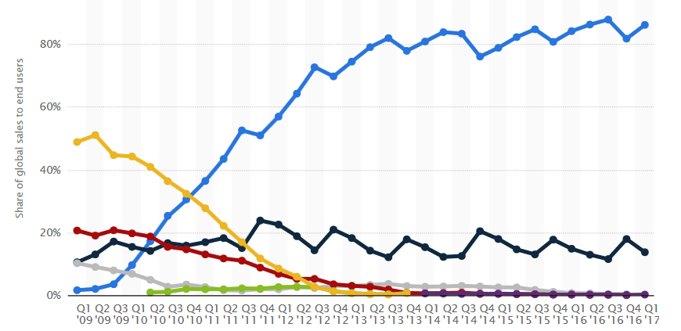
Global mobile OS market share in sales to end users from 1st quarter 2009 to 1st quarter 2017

Slide 10
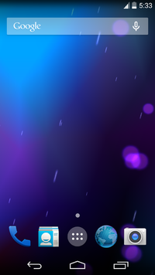
Android Interface
Touch inputs (swiping, tapping, pinching)
A virtual keyboard.
Immediate response often using the vibration capabilities.
Home screens are typically made up of app icons and widgets
Home screen is heavily customizable
Multiple Screen Support.
At the top of the screen is a status bar which can be "pulled" down to reveal a notification screen

Slide 11
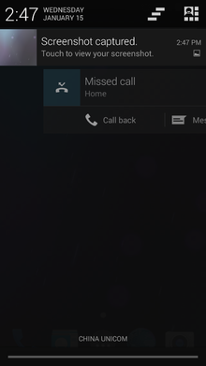
Android Interface
Third-party apps available on Google Play and other app stores can extensively re-theme the homescreen.
A music player can display playback controls, and a "missed call" notification provides buttons for calling back or sending the caller an SMS message.

Slide 12
Android Applications
Third party applications can be acquired by users either through an app store such as Google Play or the Amazon Appstore
You can also download APK file from a third-party site.
Google Play Store includes applications published by Google and third-party developers.
Developers may restrict their applications to particular carriers or countries for business reasons.
So your device needs be to pre-installed with Play Store client application

Slide 13
Android Applications
The client application filters the list of available applications down to those compatible with the user's device.
More than one million applications are available for Android in Play Store
Applications are developed primarily in the Java programming language using the Android software development kit (SDK).

Slide 14
Android Applications
The SDK includes a comprehensive set of development tools including a debugger, software libraries, a handset emulator based on QEMU, documentation, sample code, and tutorials.
The officially supported integrated development environment (IDE) is Eclipse using the Android Development Tools (ADT) plug-in
Eclipse is now being replaced with Android Studio

Slide 15
Android Applications
Other development tools are available
  Native Development Kit for applications or extensions in C or C++,
  Google App Inventor, a visual environment for novice programmers
  Various cross platform mobile web applications frameworks

Slide 16
Android Memory management
Android devices are usually battery-powered
Android is designed to manage memory (RAM) to keep power consumption at a minimum.
When an Android app is no longer in use, the system will automatically suspend it in memory – while the app is still technically "open", suspended apps consume no resources and sit idly in the background until needed again.

Slide 17
Android Memory management
Suspension has the dual benefit
  Increasing the general responsiveness of Android devices
  (since applications do not need to be closed and reopened from scratch each time)
  Also ensuring that background applications do not consume power needlessly.
Killing Application automatically when memory is low
  Done in reverse order since they were last used (oldest first).
  invisible to the user

Slide 18
Android Memory management
However, confusion over Android memory management has resulted in third-party task killers becoming popular on Google Play store;
These third-party task killers are generally regarded as doing more harm than good.

Slide 19
Android Hardware
The main hardware platform for Android is the 32-bit ARMv7 architecture.
Also provides support for the x86 architecture. For. E.g. Google TV uses a special x86 version of Android.
Minimum Requirements:
  At least 512 MB of RAM.
  Require a 32-bit ARMv7, MIPS or x86 architecture processor.
  GPU (Graphics Processing Unit) with an OpenGL ES 2.0 compatible.
Android supports OpenGL ES 1.1, 2.0 and 3.0.

Slide 20
Android Hardware
Android can also be run on x86 architecture by using an Android emulator which is part of the Android SDK
Other Emulators : BlueStacks or Andy
Optional hardware components:
  still or video cameras, GPS
  Orientation sensors
  dedicated gaming controls
  Accelerometers, gyroscopes, barometers, magnetometers,
  Proximity sensors, pressure sensors, thermometers, and touch screens.

Slide 21
Android Features
Android’s UI includes Windows, Views and Widgets
Provides an integrated browser engine - Webkit
Connectivity – WiFi, GPRS, Bluetooth, EDGE,3G
Storage — Uses SQLite, a lightweight relational database, for data storage.
Supports GSM Telephony, Media, Camera, Compass, Accelerometer,etc
Graphics : 2D and 3D graphics

Slide 22
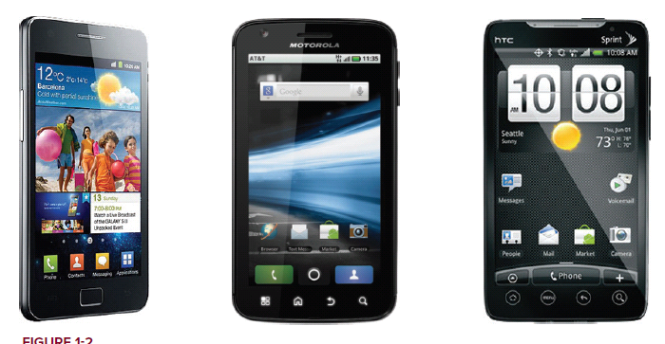
Android Devices in the Market
➤ Smartphones
➤ Tablets
➤ E-reader devices
➤ Netbooks
➤ MP4 players
➤ Internet TVs

Slide 23
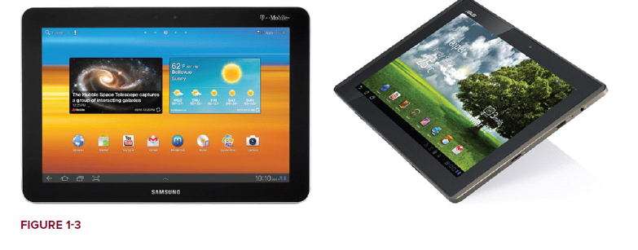

Android Devices in the Market
Tablets
E-reader devices

Slide 24
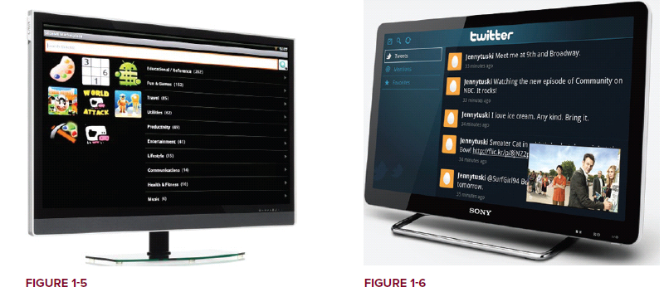
Android Devices in the Market
Android-based TV

Slide 25
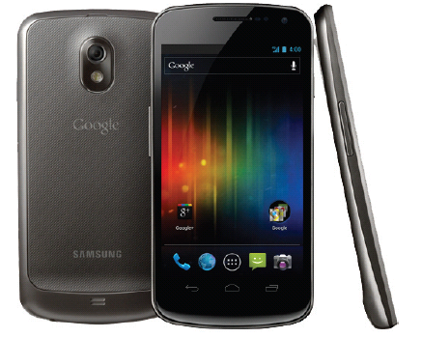
Android Devices in the Market
Samsung Galaxy Nexus device running on
Android 4.0.

Slide 26
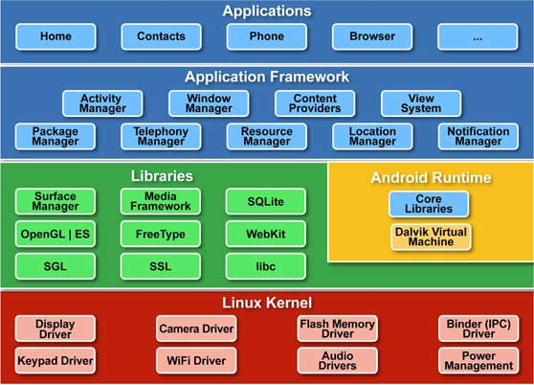
Android Software Architecture
A layered platform based on Linux Kernel

Slide 27
Android Software Architecture
Divided into five sections in four main layers
  Linux kernel — This is the kernel on which Android is based. This layer contains all the low level device drivers for the various hardware components of an Android device.
  Libraries — These contain all the code that provides the main features of an Android OS. For e.g.:
    The SQLite library provides database support so that an application can use it for data storage.
    The WebKit library provides functionalities for web browsing.

Slide 28
Android Software Architecture
  Android runtime
    The Android runtime provides a set of core libraries that enable developers to write Android apps using the Java programming language.
    The Android runtime also includes the Dalvik virtual machine that runs Android Applications
    Dalvik virtual machine is a specialized virtual machine designed specifically for Android and optimized for battery-powered mobile devices with limited memory and CPU.
  (Android applications are compiled into Dalvik executables).

Slide 29
Android Software Architecture
Application framework
  Exposes the various capabilities of the Android OS to application developers so that they can make use of them in their applications.
Applications
  At this top layer, you will find applications that ship with the Android device (such as Phone, Contacts, Browser, etc.), as well as applications that you download and install from the Android Market.
  Any applications that you write are located at this layer.

Slide 30
Android Software Architecture
Application framework
  Exposes the various capabilities of the Android OS to application developers so that they can make use of them in their applications.
Applications
  At this top layer, you will find applications that ship with the Android device (such as Phone, Contacts, Browser, etc.), as well as applications that you download and install from the Android Market.
  Any applications that you write are located at this layer.

Slide 31
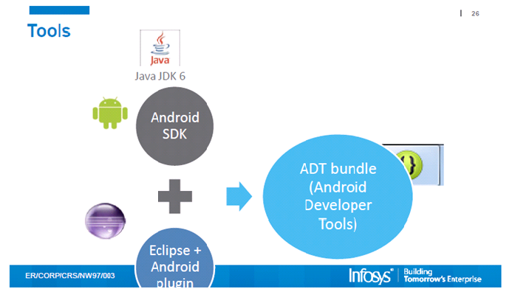
Android Development Environment and Tools

Slide 32
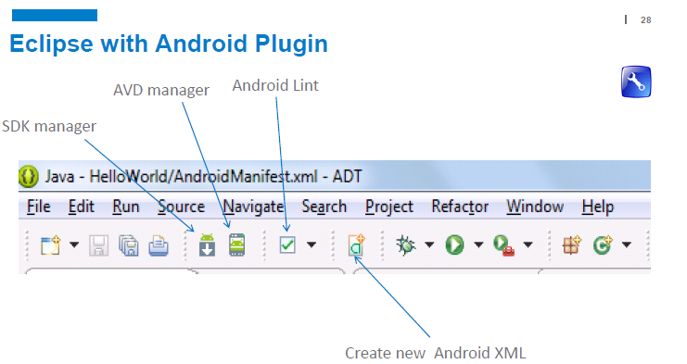
Android Development Environment and Tools

Slide 33
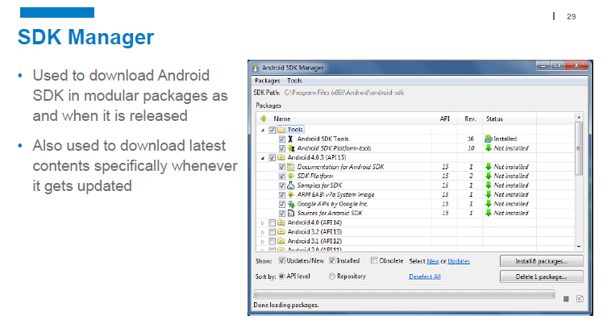
Android Development Environment and Tools

Slide 34
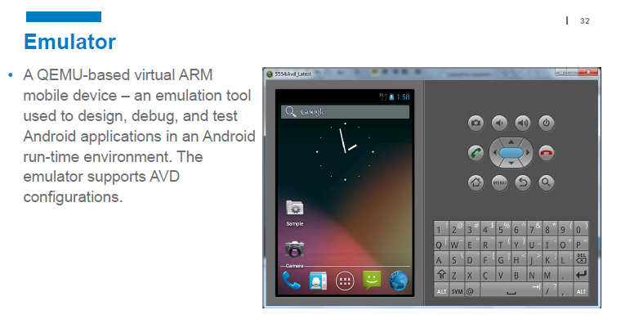
Android Development Environment and Tools

Slide 35
Android Development Environment and Tools

Slide 36
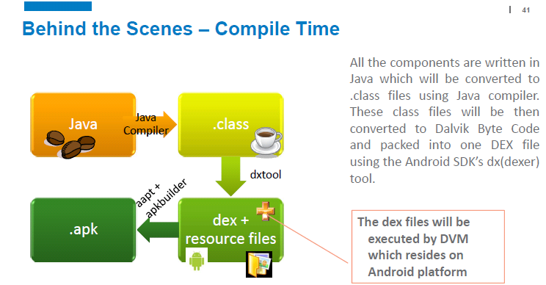
Android Development Environment and Tools

Slide 37
Android Development Environment and Tools
Using the ADT, you will be able to do the following in Eclipse:
  ➤ Create new Android application projects.
  ➤ Access the tools for accessing your Android emulators and devices.
  ➤ Compile and debug Android applications.
  ➤ Export Android applications into Android Packages (APKs).
  ➤ Create digital certificates for code-signing your APK

Slide 38
Android Development Environment and Tools
Creating Android Virtual Devices (AVDs):
    To be used for testing your Android applications.
    To be used for testing your Android applications.
    AVD consists of
        a hardware profile;
        a mapping to a system image;
        as well as emulated storage, such as a secure digital (SD) card.
    You can create as many AVDs as you want in order to test your applications

Slide 39
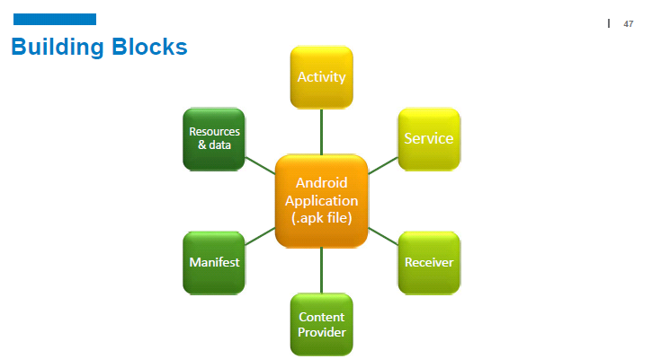
Building Blocks of Android Application

Slide 40
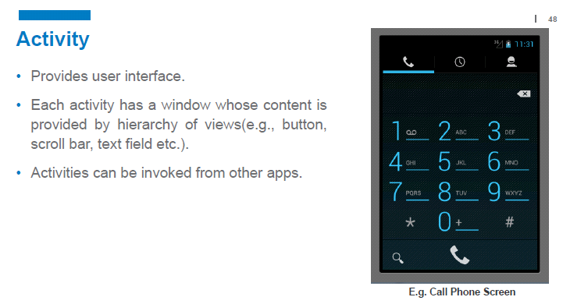
Building Blocks of Android Application

Slide 41
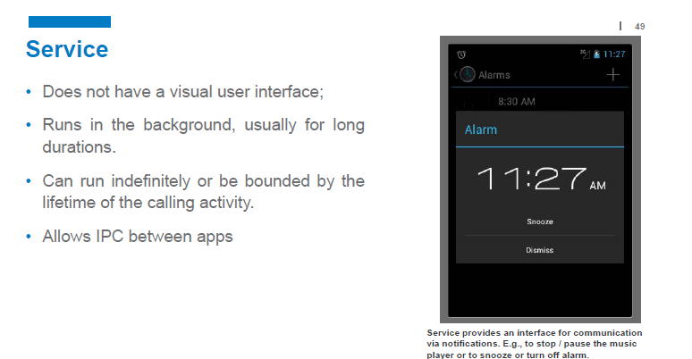
Building Blocks of Android Application

Slide 42
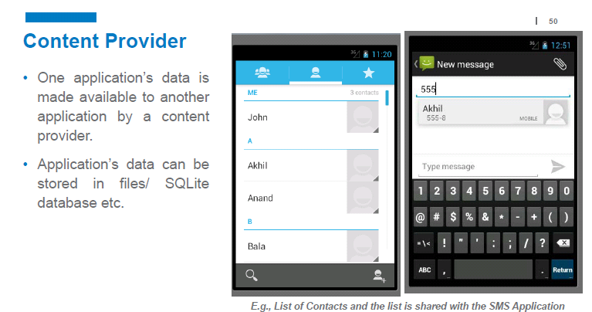
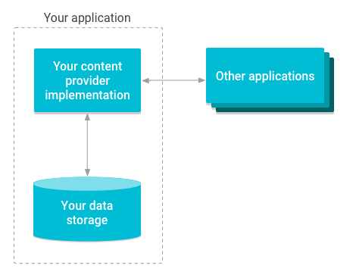
Building Blocks of Android Application

Slide 43
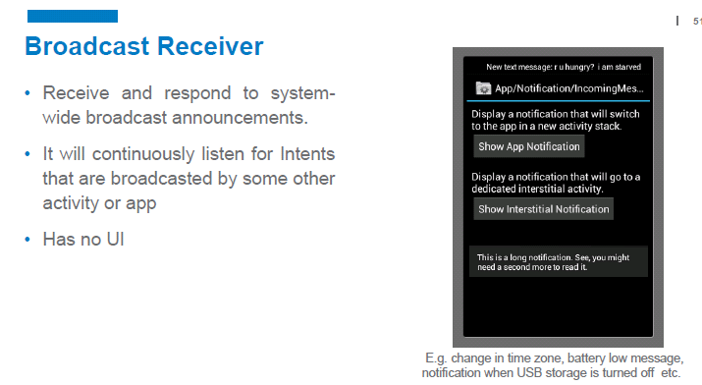
Building Blocks of Android Application

Slide 44
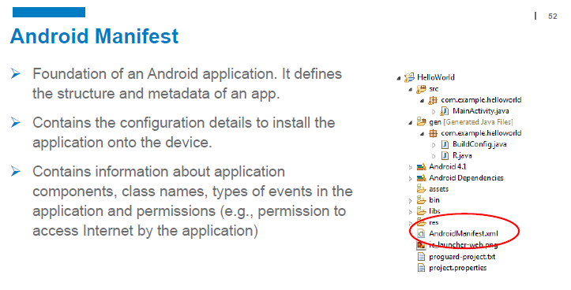
Building Blocks of Android Application

Slide 45
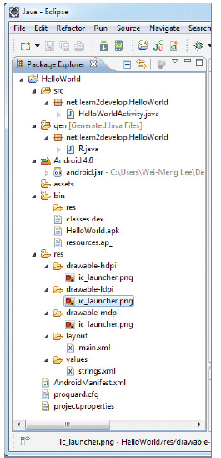
ANATOMY OF AN ANDROID APPLICATION
The various folders and their files
are as follows

Slide 46
ANATOMY OF AN ANDROID APPLICATION
The various folders and their files are as follows
src
  Contains the .java source files for your project.
  In this example HelloWorldActivity.java file is the source file for your activity. You write the code for your application in this file.
  The Java file is listed under the package name for your project, which in this case is net .learn2develop.HelloWorld.

Slide 47
ANATOMY OF AN ANDROID APPLICATION
gen
  Contains the R.java file, a compiler-generated file that references all the resources found in your project.
  All the resources in your project are automatically compiled into this class so that you can refer to them using the class.
  You should not modify this file.

Slide 48
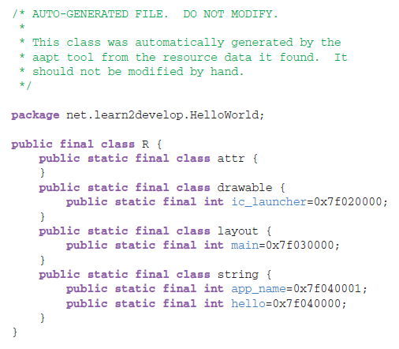
ANATOMY OF AN ANDROID APPLICATION
R.Java -

Slide 49
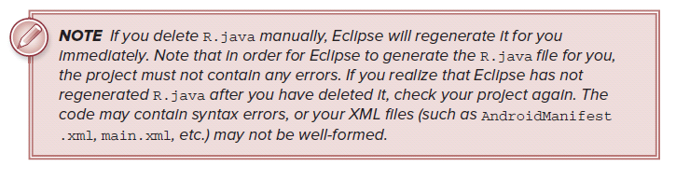
ANATOMY OF AN ANDROID APPLICATION
R.Java

Slide 50
ANATOMY OF AN ANDROID APPLICATION
Android 4.0 library
  This item contains one file, android.jar, which contains all the class libraries needed for an Android application
assets
  This folder contains all the assets used by your application, such as HTML, text files, databases, etc.

Slide 51
Building Blocks of Android Application
bin
  This folder contains the files built by the ADT during the build process.
  In particular, it generates the .apk file (Android Package).
  An .apk file is the application binary of an Android application.
  It contains everything needed to run an Android application

Slide 52
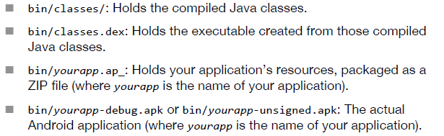
Building Blocks of Android Application

Slide 53
Building Blocks of Android Application
lib
  A folder that holds any third-party JARs your application requires.
Build.xml
  An Ant script for compiling the application and installing it on the device.

Slide 54
ANATOMY OF AN ANDROID APPLICATION
res
This folder contains all the resources used in your application.
It also contains a few other subfolders:
  Drawable - contains image files of different resolution
  Layout - contains main.xml
  values. - contains string.xml

Slide 55
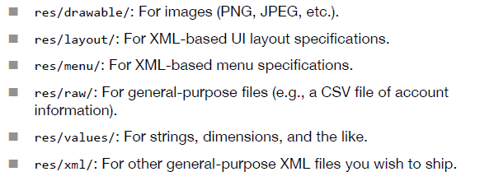
ANATOMY OF AN ANDROID APPLICATION
The res/directory tree holds resources—static files that are packaged along with your application, either in their original form or, occasionally, in a preprocessed form

Slide 56

ANATOMY OF AN ANDROID APPLICATION
The main.xml fi le defines the user interface for your activity.
    Observe the following in bold:
The @string in this case refers to the strings.xml file located in the res/values folder. Hence, @string/hello refers to the hello string defined in the strings.xml file, which is “Hello World, HelloWorldActivity!”: (see the next slide)

Slide 57
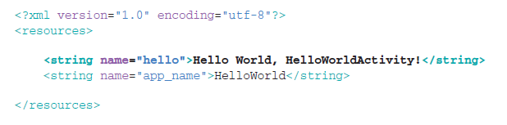
ANATOMY OF AN ANDROID APPLICATION
strings.xml file

Slide 58
ANATOMY OF AN ANDROID APPLICATION
NOTE:
It is recommended that you store all the string constants in your application in this strings.xml file and reference these strings using the @string identifier.
That way, if you ever need to localize your application to another language, all you need to do is make a copy of the entire values folder and modify the values of strings.xml to contain the string in the language that you want to display.

Slide 59
ANATOMY OF AN ANDROID APPLICATION
AndroidManifest.xml –
  This is the manifest file for your Android application.
  Includes all the configuration to install of your application onto the device
  Contains info about application component , class names and types of events in the app
  Here you specify the permissions needed by your application, as well as other features (such as intent-filters, receivers, etc.).

Slide 60
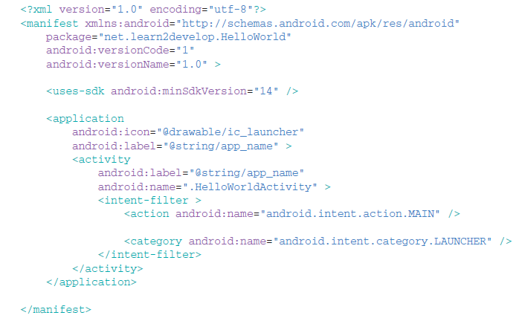
ANATOMY OF AN ANDROID APPLICATION
AndroidManifest.xml

Slide 61
ANATOMY OF AN ANDROID APPLICATION
AndroidManifest.xml : The AndroidManifest.xml file contains detailed information about the application.
It defines the package name of the application as net.learn2develop.HelloWorld.
The version code of the application is 1 (set via the android:versionCode attribute).
This value is used to identify the version number of your application. It can be used to programmatically determine whether an application needs to be upgraded.
The version name of the application is 1.0 (set via the android:versionName attribute). This string value is mainly used for display to the user.

Slide 62
ANATOMY OF AN ANDROID APPLICATION
AndroidManifest.xml :
The android:minSdkVersion attribute of the <uses-sdk> element specifies the minimum version of the OS on which the application will run.
The application uses the image named ic_launcher.png located in the drawable folders.
The name of this application is the string named app_name defined in the strings.xml file.
There is one activity in the application represented by the HelloWorldActivity.java file.
The label displayed for this activity is the same as the application name.

Slide 63
ANATOMY OF AN ANDROID APPLICATION
AndroidManifest.xml :
Within the definition for this activity, there is an element named <intent-filter>:
The action for the intent filter is named android.intent.action.MAIN to indicate
that this activity serves as the entry point for the application.
The category for the intent-filter is named android.intent.category.LAUNCHER to indicate that the application can be launched from the device’s launcher icon.

Slide 64
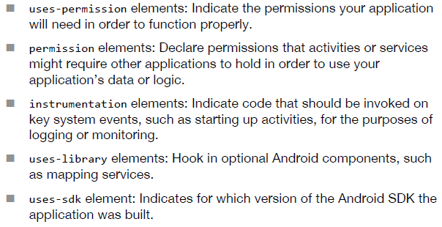
ANATOMY OF AN ANDROID APPLICATION
AndroidManifest.xml :

Slide 65
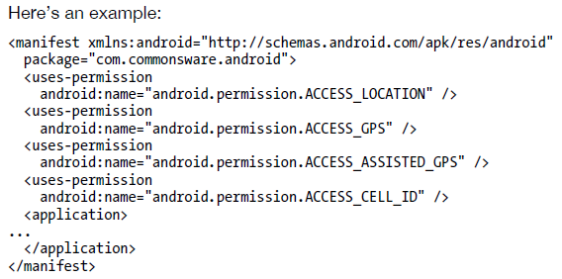
ANATOMY OF AN ANDROID APPLICATION
AndroidManifest.xml :
In this example, the manifest has uses-elements to indicate some device capabilities the application will need—in this case, permissions to allow the application to determine its current location.

Slide 66
ANATOMY OF AN ANDROID APPLICATION
AndroidManifest.xml :
You may have one or more provider elements, indicating content providers, which are the components that supply data to your activities and, with your permission, other activities in other applications on the device.
Finally, you may have one or more service elements, describing services, which are long-running pieces of code that can operate independently of any activity.
    The quintessential example is the MP3 player, where you want the music to keep playing even if the user pops open other activities and the MP3 player’s user interface is“misplaced.”

Slide 67

Android Studio
Android Studio is the official integrated development environment (IDE) for Google's Android operating system.
Built based on JetBrains' IntelliJ IDEA software and designed specifically for Android development.
Available for download on Windows, macOS and Linux
Android Studio was announced on May 16, 2013 at the Google I/O conference.
The current version is 2.3.3, released June 2017.

Slide 68
Android Studio
What is IntelliJ IDEA?
  IntelliJ IDEA is a special programming environment or integrated development environment (IDE) largely meant for Java.
  It is developed by a company called JetBrains, which was formally called IntelliJ.
  It is available in two editions: the Community Edition which is licensed by Apache 2.0, and a commercial edition known as the Ultimate Edition
  Android Studio based on the open source community edition of IntelliJ IDEA

Slide 69
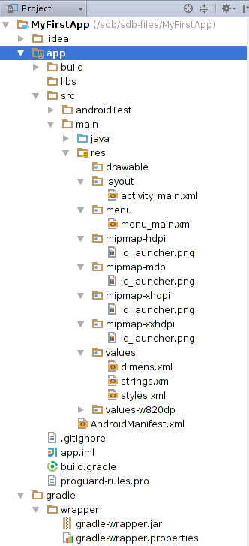
Android Studio
Folder Structure

Slide 70
Android Studio
AndroidManifest.xml
  It names the Java package for the application. The package name serves as a unique identifier for the application.
  It describes the components of the application, (activities, services, broadcast receivers, and content providers that compose the application)
  It also names the classes that implement each of the components and publishes their capabilities, such as the Intent messages that they can handle

Slide 71
Android Studio
AndroidManifest.xml
  It determines the processes that host the application components.
  It declares the permissions that the application must have in order to access protected parts of the API and interact with other applications.
  It also declares the permissions that others are required to have in order to interact with the application's components.

Slide 72
Android Studio
AndroidManifest.xml
  It lists the Instrumentation classes that provide profiling and other information as the application runs.
  It declares the minimum level of the Android API that the application requires.
  It lists the libraries that the application must be linked against.

Slide 73
Android Studio
java
  Contains the Java source code files, separated by package names, including JUnit test code.
Resource folder (res/)
  Contains all non-code resources, such as XML layouts, UI strings, and bitmap images, divided into corresponding sub-directories.

Slide 74
Android Studio
Gradle Script group
  Shows all the project's build-related configuration files
build.gradle (module)
  This defines the module-specific build configurations.
build.gradle (project)
  This defines your build configuration that apply to all modules.

Slide 75
The life cycles of an activity
From the moment an activity appears on the screen to the moment it is hidden, it goes through a number of stages, known as an activity’s life cycle.
The Activity class provides a number of callbacks that allow the activity to know that a state has changed.
Within the lifecycle callback methods, you can declare how your activity behaves when the user leaves and re-enters the activity.

Slide 76
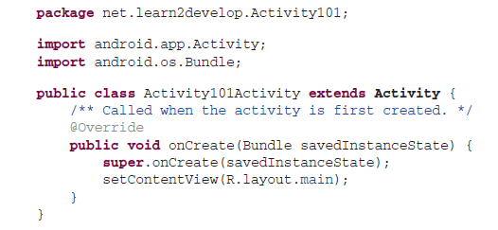
The life cycles of an activity
To create an activity, you create a Java class that extends the Activity base class. Your activity class loads its UI component using the XML fi le defined in your res/layout folder

Slide 77
The life cycles of an activity
To navigate transitions between stages of the activity lifecycle, the Activity class provides following set od callbacks:
onCreate()
onStart()
onResume()
onPause()
onStop()
onDestroy()
onRestart()

Slide 78
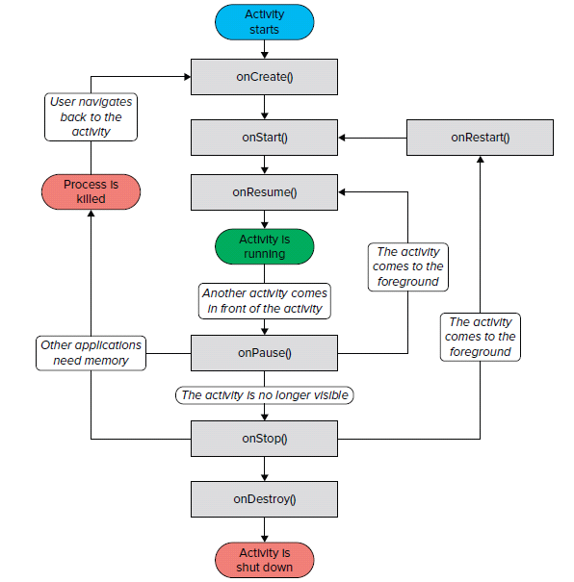
The life cycles of an activity

Slide 79
The life cycles of an activity
onCreate()
  Called when the activity is first created
  You must implement this callback
  You perform basic application startup logic that should happen only once for the entire life of the activity
  Your activity does not reside in the Created state. After the onCreate() method finishes execution, the activity enters the Started state

Slide 80
The life cycles of an activity
onStart()
    When the activity enters the Started state, the system invokes this callback.
    The onStart() call makes the activity visible to the user.
    the activity does not stay resident in the Started state. Once this callback finishes, the activity enters the Resumed state

Slide 81
The life cycles of an activity
onResume()
    When the activity enters the Resumed state, it comes to the foreground, and then the system invokes the onResume() callback.
    This is the state in which the app interacts with the user.
    The app stays in this state until something happens to take focus away from the app.
    When an interruptive event occurs, the activity enters the Paused state
    If the activity returns to the Resumed state from the Paused state, the system once again calls onResume() method.

Slide 82
The life cycles of an activity
onPause()
Called when the user is leaving your activity
onPause() execution is very brief, and does not necessarily afford enough time to perform save operations.
Use the onPause() method to pause operations such animations and music playback that should not continue while the Activity is in the Paused state, and that you expect to resume shortly.

Slide 83
The life cycles of an activity
onPause()
the activity remains in this state until either the activity resumes or becomes completely invisible to the user.
If the activity resumes, the system once again invokes the onResume() callback.
If the activity becomes completely invisible, the system calls onStop().

Slide 84
The life cycles of an activity
onPause()
the activity remains in this state until either the activity resumes or becomes completely invisible to the user.
If the activity resumes, the system once again invokes the onResume() callback.
If the activity becomes completely invisible, the system calls onStop().

Slide 85
The life cycles of an activity
onStop()
your activity is no longer visible to the user, it has entered the Stopped state, and the system invokes the onStop() callback.
The system may also call onStop() when the activity has finished running, and is about to be terminated.
use onStop() to perform relatively CPU-intensive shutdown operations.
When your activity enters the Stopped state, the Activity object is kept resident in memory.

Slide 86
The life cycles of an activity
onDestroy()
Called before the activity is destroyed
This is the final call that the activity receives.
the Activity object is no more resident in memory
The onDestroy() callback releases all resources
onRestart() — Called when the activity has been stopped and is restarting again

